Slide 1
Project Title: FATIGUE RISK MANAGEMENT #12486
Charter Template
Business Case/Objectives:
SPDC spends a large amount of money on Medical treatment,referrals,first aid cases,lost time injury and Medvac year round in other to reduce this as much as possible.
To achieve and sustain LTI free man hours .
To build a heathy workforce/environment.
To boost engagement/inclusiveness between management and workforce.
To have highly informed & motivated personnel, thus maximizing production.
To develop individual skills in fatigue risk management.
Potential Benefits & Measurement:
Healthy high performing people.
To reduce medical care cost and increase personnel ownership of good healthy practices and behaviour in the long run
Incident and accident free, zero harm to people &asset.
Measurement details
Any planned shift length excluding overtime and handovers greater than 12 hours within a 24 hour period; or
Overtime resulting in working hours exceeding 12 hours more than once per month;
Overtime or Call-outs resulting in more than 16 working hours in one calendar day; or
Day-to-day changes to shift start times that are a change of more than three hours; or
More than 28 days of consecutive work without at least 24 hours of continuous time-off.
Project Scope/Actions :
Develop a Fatigue Risk Management plan approved and signed off.
Training plan approved and implemented
Document HSSE critical positions in FRMP and create awareness.
Evidence of FR self reporting by workers to supervisors, no disciplinary actions to the workers
Critical Success Factors:
Support from Asset leadership
Buy-in from personnel
High-level Timeline:
L0-L1: JULY 2018
L2: JULY 2018
L3: JULY 2018
L4: AUGUST 2018
L5: DECEMBER 2018
Project Sponsor: Bashorun, O/Onyeka Ike
Implementation Lead: Amaechi A/Agunwa C.
Project Team: Tayo Salami, Hassan Salisu, Musa Mohammed, Eniola Aboaba
.

Slide 2
project cadence commitment template
No. | Action | Action Party | Threat | Due Date | Status
1-1.1 | Develop Draft Cadence Charter and share with Team | Amaechi /Chidiebere |  | 01/06/18
1-1.2 | Develop FRMP, approved and signed off | PUM |  | 31/07/18
1-1.3 | Develop FRM Training Plan for Imor, approved for implementation | PUM |  | 31/07/18
1-1.4 | Identify HSSE Critical positions in FRMP | FRM Champions |  | 31/07/18
1-1.5 | Create Rest room for Workers likely to be impacted with Fatigue. | PUM |  | 31/07/18
1-1.6 | Carry out routine checks for fatigue in exposed personnel | Amaechi /Chidiebere |  | Continuous activity
1-1.7 | Include Fatigue, routinely in all incident investigations; incident reports should have a section on the role of fatigue in the incident | PUM/HSE/OH |  | Continuous activity
1-1.8 | Include discussion on Fatigue risk management in toolbox talks and HSE briefing | ALL |  | Continuous activity
1-1.8 | Evidence that Fatigue Key Performance indicators are identified, documented, tracked and reported annually; actions are completed timely | HSE (Grace/umaru) |  | Continuous activity
1-1.9 | Support with evidence that Individuals know their Roles and responsibilities for FRM | HSE (Grace/umaru) |  | 31/08/2018
1-2.0 | Provide Fatigue Risk Management related data streams and tracked them annually; Ensure actions for improvement are known | Amaechi /Chidiebere |  | 31/12/2018

Slide 3
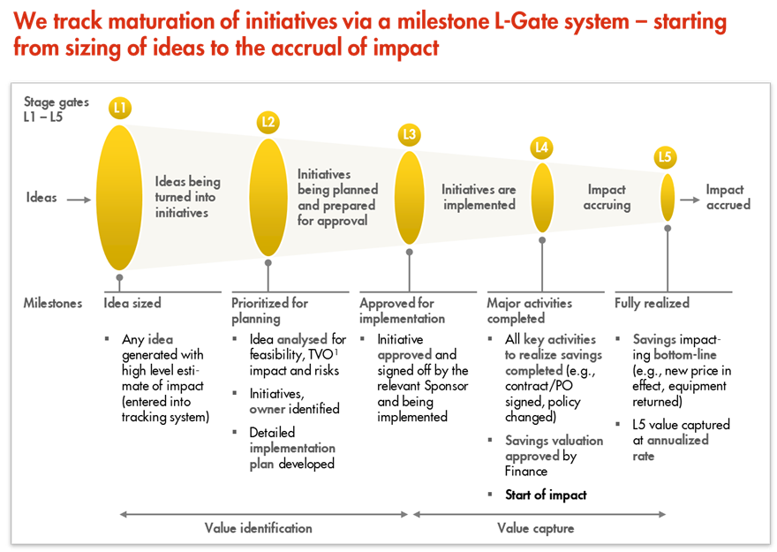
L1 – L5 Gates

